Slide 1

Project Demo
Team Infinity: Hannah Pfeifer, Adam Chathankeo, Sean Lin, Craig Sanders
Notes:
Craig

Slide 2
Agenda
Purpose & User Story
Our Project & MVP
Core Features
High-level Architecture
Our Tools & Process
Our Team
Demo
Future Features & Improvements
Team Dynamics, Challenges, & Reflection
Questions
Notes:
Craig

Slide 3
Purpose & User Story
Problem:
For years, CSPB students have a hard time finding course reviews, which are scattered and buried in various places (Buff Portal course evals, Discord, Reddit, blogs, messages)
Needs:
Find, browse, and write course reviews more easily in one place
Solution:
A website built to help students review CSPB courses
Notes:
Craig

Slide 4

Our Project & MVP
CSPB Course Reviews
A website that enables CSPB students
to centrally browse, write, and manage
course reviews
MVP
Our MVP delivers essential features,
all tested and functional
Notes:
Adam

Slide 5
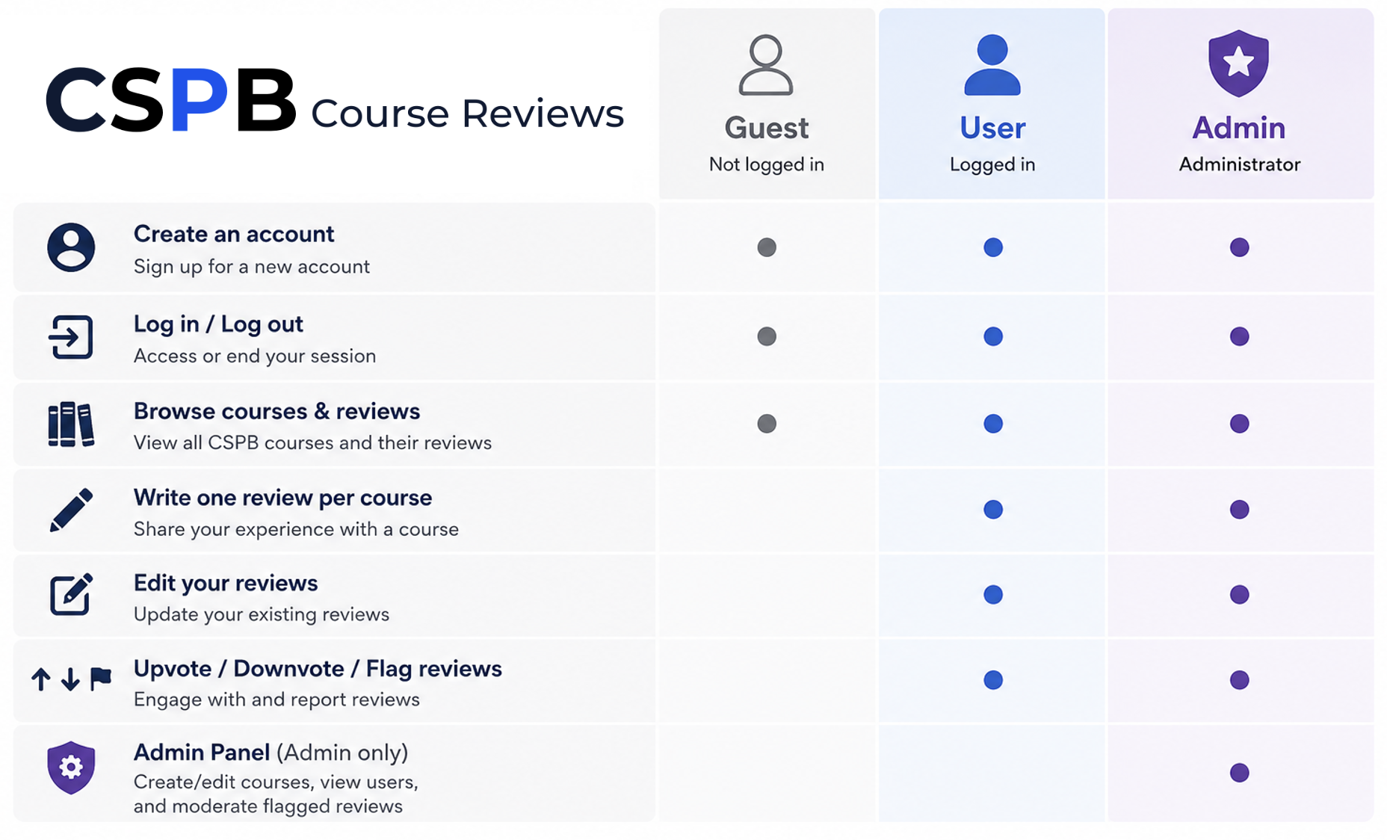
Core Features
Notes:
Hannah
Create an account and log in/out
Everyone (users and guests) can browse a list of CSPB courses and their respective reviews
All users can write one review per course, edit reviews, and upvote/downvote/flag reviews
Admins have extra privileges to create/edit courses, view users and moderate flagged reviews via an Admin Panel

Slide 6
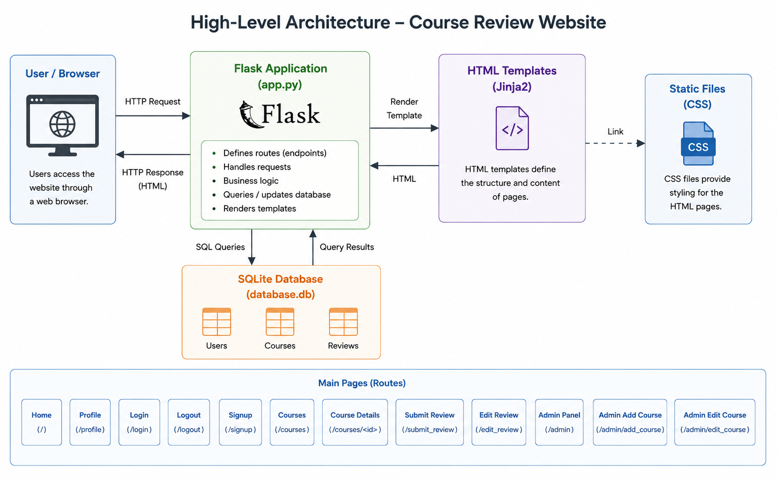
Notes:
Sean For this project, we use a software architecture based on Flask. Users can interact with the application through a web browser by sending HTTP requests. The Flask application (app.py) defines routes for various pages, handles user requests, checks logic, and communicates with the SQLite database. The database stores the data in three main tables: Users, Courses, and Reviews. SQLite is easy to deploy and to maintain. Flask can retrieve and update data through database API methods and then render HTML pages using Jinja templates. We also use CSS files to provide a consistent visual design for all HTML pages. This architecture allows us to separate the application into several aspects: routing, data management, data presentation, and styling. It makes the project easier to develop, maintain, and expand.

Slide 7
Our Tools
Tool & Use | Evaluation
Google Docs: Brainstorm, manage tasks & milestones, organize & share data | Excellent: Ended up being our main planning & design document. Commenting feature useful for asynchronous work
Discord: Discuss designs, make decisions, and coordinate tasks | Excellent: Most used for daily communication and informal check-in meetings
Zoom: Hold regular team meetings | Good: Used for formal meetings and milestone recordings
GitHub: Manage code and send pull requests | Excellent: Invaluable for version control
Trello: Manage tasks and have task visuals | OK: After using Google Docs, was redundant and mostly went unused
Notes:
Craig

Slide 8
Our Process
Propose project ideas
Clarify user stories, software behaviors, and define the MVP scope
Create mockups to illustrate product design
Create Flask routes and HTML templates
Design and create SQLite database and API methods
Connect the front-end and the back-end
Test the prototype, troubleshoot issues, and add missing pieces
Notes:
Adam
Weekly scrum meetings to discuss each milestone

Slide 9
Our Team
All
Flask routes, SQL, CSS, and HTML related to our individual pages
Hannah
Main Flask backend structure
Overall website CSS styling, HTML skeletons for each page
Pages: Base, Home, About, Browse Courses, Course Details
Adam
Flask user sessions and authentication
Pages: Login, Sign Up, Logout, Profile, User Update Info
Sean
SQL backend structure and methods (dbAPI, create and reset db)
Pages: Admin Panel, Admin Edit & Add Course, Edit Review
Craig
Repo structure / skeleton
models.py backend methods and course objects
Pages: Submit Review form and related functions for inserting into db
Notes:
Hannah
This is an overview of what each team member worked on

Slide 10
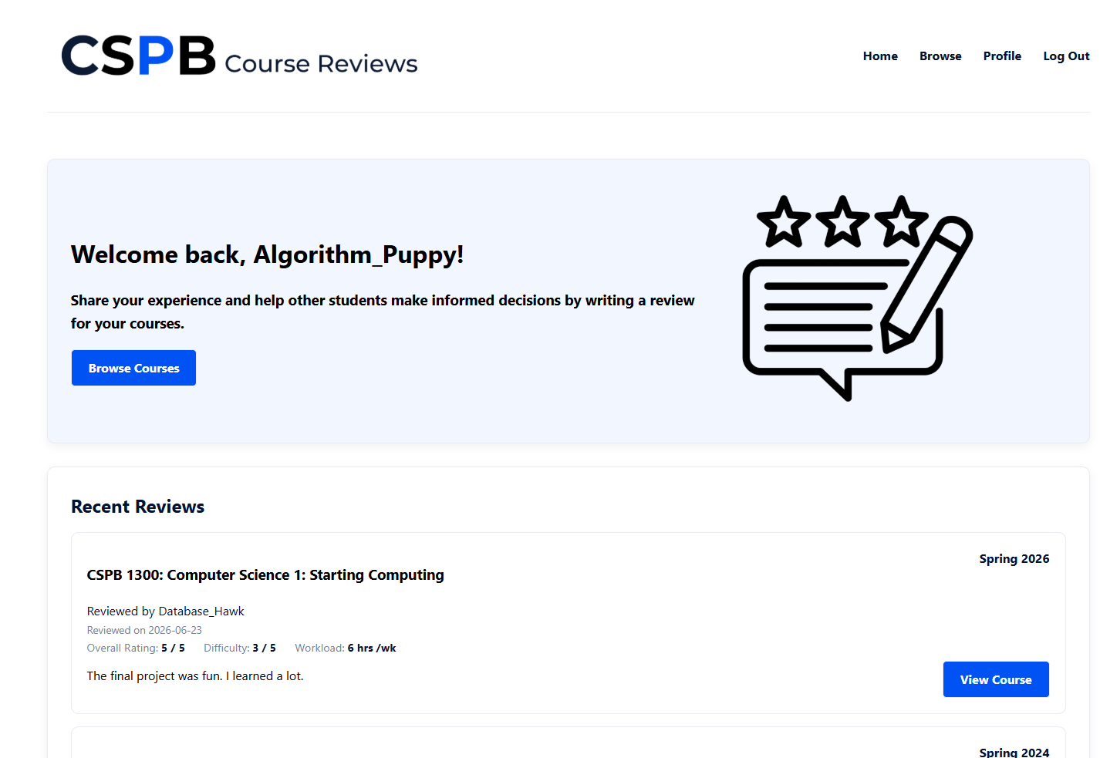
Demo
Notes:
Hannah
Go through core features
Show home, about pages as guest first
Create account and log in, note how nav bar changes
Browse courses and reviews on course detail page. Review actions. Write a review, edit review
Login as admin to do admin actions (add & edit courses)
Show that data persists between sessions
Mention a few things we plan to add in the future during demo

Slide 11
Future Features & Improvements
Profile/course pictures
Username, email, & password validation
Expand admin operations
More review features (commenting)
Search filters for courses & reviews
Better responsiveness for smaller screens
Increase database resilience
Notes:
Sean
If our schedule permits, we are interested in working on the project even after this semester.
Support adding profile/course pictures and the ability to edit them
Support more username, email, password validation - Password hashes, retrieve forgotten username/password, automatic username generation, change username
Support more admin operations: ban users, give or remove admin privileges, delete flagged reviews
Support more review features - leave comments on each review
Support filtering - add filters for searching courses and reviews and sort reviews in certain ways
Better responsiveness for smaller screens such as smartphones - currently works best on desktop size screens
Increase database resilience - make the DB more defensive against invalid input, and we may migrate to postgresql and separating app from db

Slide 12
Reflection - Team Dynamics
New team members
Different work styles and experience levels while learning and implementing software development methodologies
Mitigation: A lot of communication, divide work out to play to individual strengths, & help each other out when needed.
Time management
Our actual development time was less than one month. As a result, our last weeks were very intense.
In retrospect, we could have finished the design phase a little earlier and started coding a little sooner.
Notes:
Adam

Slide 13
Reflection - Team Dynamics
Collaborative Learning / Problem Solving
Although our team members had different skill sets and experience levels, everyone was willing to help each other whenever someone had trouble understanding a topic from the course. Working together made it easier to solve problems and learn from one another.
Notes:
Adam

Slide 14
Reflection - Technical Challenges
Technical dependencies and different time zones
There were several technical dependencies (ex: back-end, DB, and methods had to be finished to implement front-end features), waiting to merge PRs, etc.
Mitigation: Weekly team meeting to regroup and daily communication on Discord
Great learning experience
Despite unfamiliarity with tools, we managed to deliver all core features.
This project has taught us how to build a software product, from a mere idea to a functional and scalable prototype.
Notes:
Craig

Slide 15
Questions?

Slide 16
Thank You!

